Slide 1
5g Health Concerns; Electromagnetic Radiation
PRESENTED BY
DR EFFIONG WILSON 1.(Bsc,MBBCh,FWACS)
RADIOLOGIST
UUTH, UYO, AKWA IBOM STATE

Slide 2
CONTENTS
DEFINITION OF 5G
BRIEF HISTORY OF EVOLUTION OF 5G
5G AS ELECTROMAGNETIC RADIATION
TYPES OF ELECTROMAGNECTIC RADIATION
HEALTH IMPACT OF 5G
GENUINE CONCERNS
SAFTY STANDARDS
CONCLUSION
REFRENCES

Slide 3
DEFINITION OF 5G
Intelecommunication, 5G is the fifth generation technology standard for cellular networks, which cellular companies began deploying worldwide in 2019. It is the planned successor to the 4G networks which provide connectivity to most current cellphones.¹
Like its predecessors, 5G networks are cellular networks, in which the service area is divided into small geographical areas called cells.
All 5G wireless devices in a cell are connected to the Internet and telephone network by radio waves through a local antenna in the cell.
The main advantage of the new networks is that they will have greater bandwidth, giving faster download speeds,¹
eventually up to 10 gigabits per second (Gbps).²

Slide 4
BRIEF HISTORY OF EVOLUTION OF 5G
Every successive generation of wireless standards – abbreviated to “G” – have introduced advances in data-carrying capacity.³
The first generation of mobile networks – or 1G was launched by Nippon Telegraph and Telephone (NTT) in Tokyo in 1979.
1G technology suffered from a number of drawbacks.
Coverage was poor and sound quality was low.
There was no roaming support between various operators and, as different systems operated on different frequency ranges, there was no compatibility between systems.
Worse of all, calls weren’t encrypted, so anyone with a radio scanner could drop in on a call.

Slide 5
2G, was launched under the GSM standard in Finland in 1991
For the first time, people could send text messages (SMS), picture messages, and multimedia messages (MMS) on their phones.
This led to mass-adoption by consumers and businesses alike on a scale never before seen.
Speed 9.5kb/s through 40kb/s to 500kb/s (edge connection)

Slide 6
3G (The ‘Packet-Switching’ ) revolution was launched in 2001 and aimed to standardize the network protocol used by vendors.
This meant that users could access data from any location in the world as the ‘data packets’ that drive web connectivity were standardized.
This made international roaming services a real possibility for the first time.
4 times faster than 2G
also led to the rise of new services such as video conferencing, video streaming and voice over IP (such as Skype).
In 2002, the Blackberry was launched, and many of its powerful features were made possible by 3G connectivity.

Slide 7
4G (The Streaming Era) was first deployed in Stockholm, Sweden and Oslo, Norway in 2009 as the Long Term Evolution (LTE) 4G standard.
4G offers fast mobile web access (up to 1 gigabit per second for stationary users) which facilitates gaming services, HD videos and HQ video conferencing.

Slide 8
5G: The Internet of Things Era
it’s the IoT in your pocket; a number of network-connected sensors that help you accomplish everything from navigation to photography to communication and more.
The IoT will see data move out of server centers and into what are known as ‘edge devices’ such as Wi-Fi-enabled appliances like fridges, washing machines, and cars.
As 4G’s latency of between 40ms and 60ms is too slow for real-time responses, a number of researchers started developing the next generation of mobile networks
The superior connectivity offered by 5G promised to transform everything from banking to healthcare.
5G offers the possibility of innovations such as remote surgeries, telemedicine and even remote vital sign monitoring that could save lives.

Slide 9
5G as electromagnetic radiation
EMR is the term given to energy travelling across empty space.
All forms of emr travel with the same frequency as light when in vacuum, very close to 3x10⁸ms⁻¹ and not significantly less in air.
They are named according to the way they are produced and special properties they posses.
x-rays (from x-ray tubes), gamma rays (from radioactive nuclei), to radio waves (from radio transmitters), light (from your incandescence source or sun).
Types of radiation: ionizing and non-ionizing radiation.

Slide 10
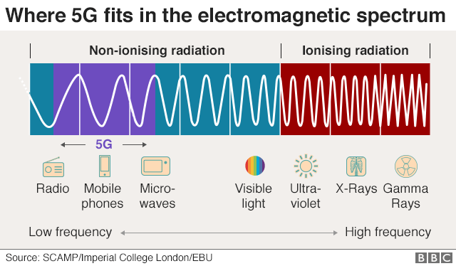
Types of electromagnectic radiation

Slide 11
Radiofrequency and Microwave Frequency Exposures
Occupational Exposures
Radar and communications equipment,
industrial and commercial ovens
Other Exposures
Cell Phones

Slide 12
health effect of radiofrequency and microwave exposure
These do not cause COVID-19.
There is a great deal of controversy regarding potential cancer risks, particularly with cell phone use.
5g is non-ionizing radiation "which means it lacks sufficient energy to break apart DNA and cause cellular damage," says David Robert Grimes, physicist and cancer researcher.⁴
We know that exposure to radio and microwave frequency sources can cause burns and clinically this is what you are most likely to see.

Slide 13
Should we be worried about 5G transmitter masts?
5G technology requires a lot of new base stations - these are the masts that transmit and receive mobile phone signals.
But crucially, because there are more transmitters, each one can run at lower power levels than previous 4G technology, which means that the level of radiation exposure from 5G antennas will be lower.
The UK government guidelines on mobile phone base stations says radio frequency fields at places normally accessible to the public are many times below guideline levels.⁴

Slide 14
Genuine concerns
more than 500 studies, have found harmful biologic or health effects from exposure to RFR at intensities too low to cause significant heating in rats.⁵
Citing this large body of research, more than 240 scientists who have published peer-reviewed research on the biologic and health effects of nonionizing electromagnetic fields (EMF) signed the International EMF Scientist Appeal, which calls for stronger exposure limits.⁵
Moreover, these limits should be based on a biological effect on human, not a change in a laboratory rat’s.

Slide 15
Safety standards
The Federal Communications Commission (FCC);set RFR exposure limits which regulate the intensity of exposure, taking into account the frequency of the carrier waves
For 5G equipment, the signals from commercial wireless transmitters are typically far below the RF exposure limits at any location that is accessible to the public.”
FDA; “The weight of scientific evidence has not linked cell phones with serious health problems.”⁵

Slide 16
CONCLUSION
Large human studies required to evaluate effect of 5g.
5g is non-ionizing radiation and safe for use.
Safe for use at exposure limited set by the FCC and NCC (Nigeria).
The benefit of 5G outweighs any perceived risk.

Slide 17
Refrences
1. de Looper, Christian (March 27, 2020). "What is 5G? The next-generation network explained". Digital Trends. Retrieved May 14, 2020.
2. Hoffman, Chris (January 7, 2019). "What is 5G, and how fast will it be?". How-To Geek website. How-To Geek LLC. Archived from the original on January 24, 2019. Retrieved May 14, 2020.
3. BrainBridge.(2019). From 1G to 5G: A brief history of the evolution of mobile standards. Retrieved from https://www.brainbridge.be/news/from-1g-to-5g-a-brief-history-of-the-evolution-of-mobile-standards.
4. Reality check team.(15 July 2019). Does 5G pose health risk ?. Retrieved May15,2020 from https://www.bbc.com/news/world-europe-48616174
5.Dave J.(March 31, 2020). How worried should you be about health risks of 5G ?. Retrieved May 15, 2020 from https://www.howtogeek.com/423720/how-worried-should-you-be-about-the-health-risks-of-5g/

Slide 18
Thank you

